Slide 1
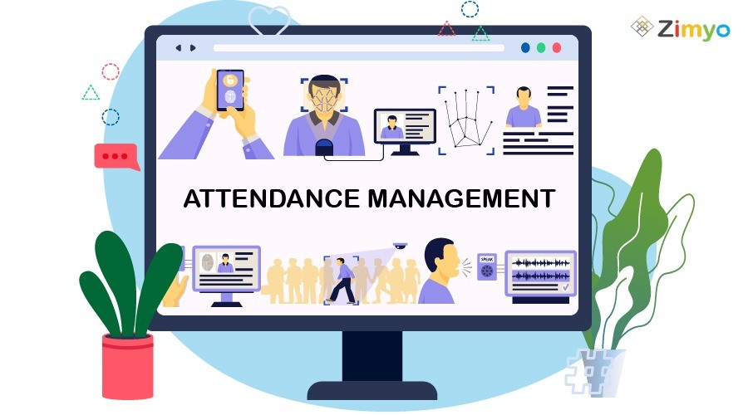
Attendance Management System
Presented By - Rini Sachan
Saloni Jamgade
Sanskar Malviya
Saransh Pal

Slide 2
Contents
Introduction
Problem Domain
Physical Study
Flow Chart
ER Diagram & Detail Design
Implementation & testing
Application
Future Scope
Conclusion
Presentation Title

Slide 3

Introduction
The Attendance Management System using QR and Facial Recognition is a minor project designed to automate the process of recording attendance in educational institutions and workplaces. This system uses a combination of two technologies: QR code scanning and facial recognition. Students or employees scan their unique QR code using a mobile device, which then captures an image of their face using the camera. The facial recognition algorithm compares the image with the database and marks the attendance.

Slide 4


Aim This system eliminates the need for manual attendance taking, reduces errors and time, and improves overall accuracy. Additionally, the system provides real-time attendance data, generates reports, and simplifies the management of attendance records. The use of QR code scanning and facial recognition technology makes the attendance process more secure and efficient, while also ensuring the privacy of individual users. Overall, the aim of this project is to provide an effective and efficient solution for attendance management in various settings.

Slide 5


Problem Domain
Some of the common problems that this system aims to address are: • Time-consuming process: Manual attendance recording is a time-consuming process and requires a lot of effort, especially in larger institutions. • Inaccurate attendance records: The manual attendance recording process is prone to errors, leading to inaccurate attendance records that can affect students' or employees' performance. • Security concerns: Traditional attendance systems can be manipulated, and the possibility of proxy attendance or identity theft is high. • Manual record-keeping: Manual attendance recording involves maintaining physical attendance registers, which can be misplaced or lost, making it difficult to manage and access the attendance records. • Delayed reporting: Manual attendance recording can result in delayed reporting, making it challenging to identify and address attendance issues promptly.

Slide 6
Physical study
Hardware
This could include studying the physical devices used for capturing attendance data, such as biometric devices (e.g., fingerprint scanners, facial recognition camera, Qr scanners.)
Infrastructure
This could involve studying the physical infrastructure needed to support attendance management systems, such as cabling, network connections, servers, and storage devices
Physical processes
This could include studying the physical processes involved in managing attendance, such as data capture, data processing, and data storage.
Integration with existing systems
This could involve studying how attendance management systems integrate with existing physical systems or processes, such as payroll systems, access control systems, or human resources management systems.
User experience
his could involve studying the physical aspects of how users interact with attendance management systems, such as the physical layout and design of user interfaces, the ease of use of physical devices, and the overall user satisfaction
Cost and maintenance:
This could involve studying the physical costs associated with implementing and maintaining attendance management systems, including the costs of hardware, infrastructure, and ongoing maintenance.

Slide 7
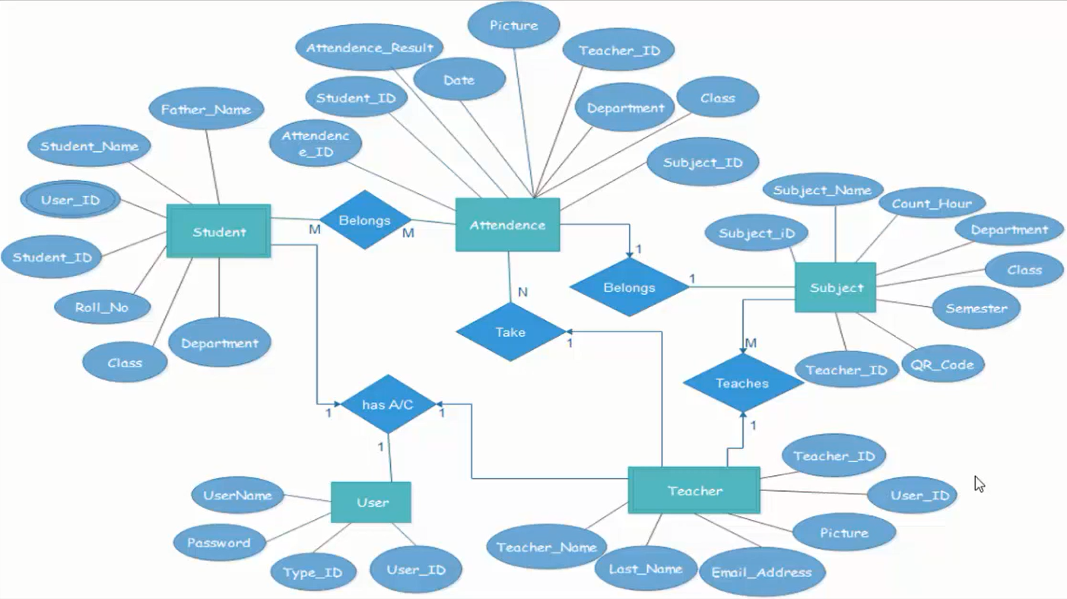
ER Diagram For QR Attendance

Slide 8
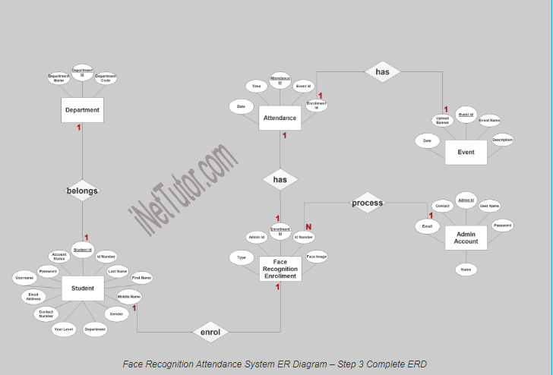
ER Diagram For Face Recognition Attendance

Slide 9
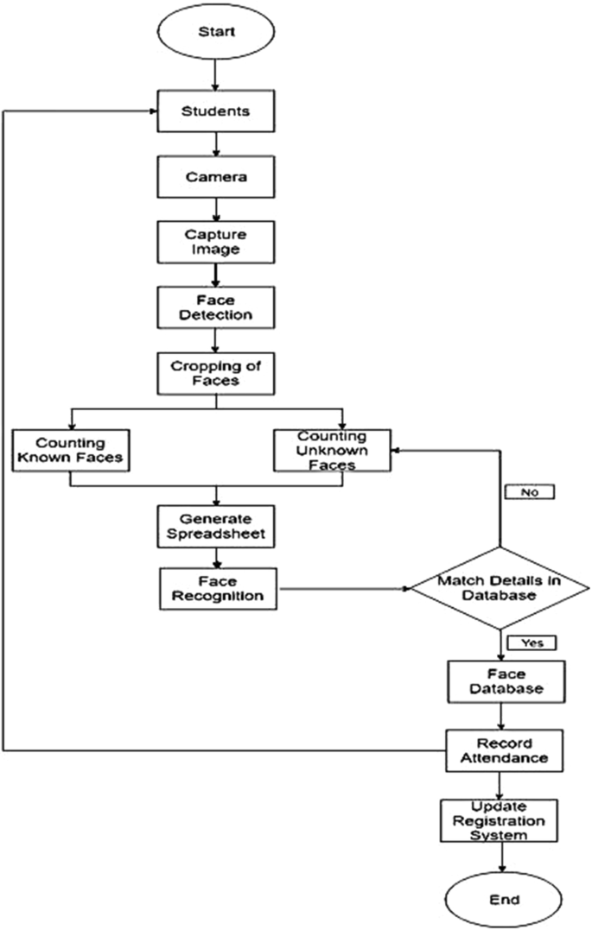
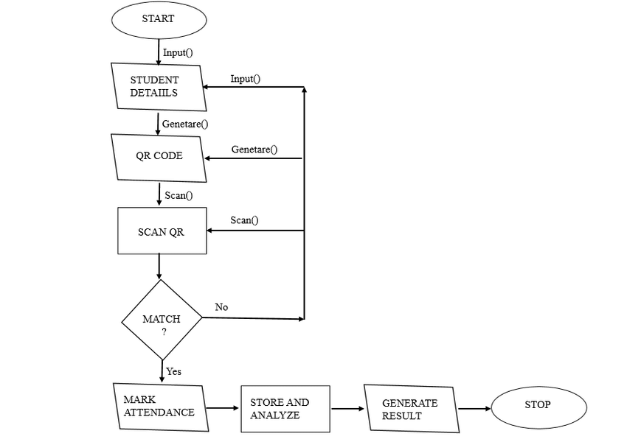
Flow Chart
Face Detection System
QR System

Slide 10
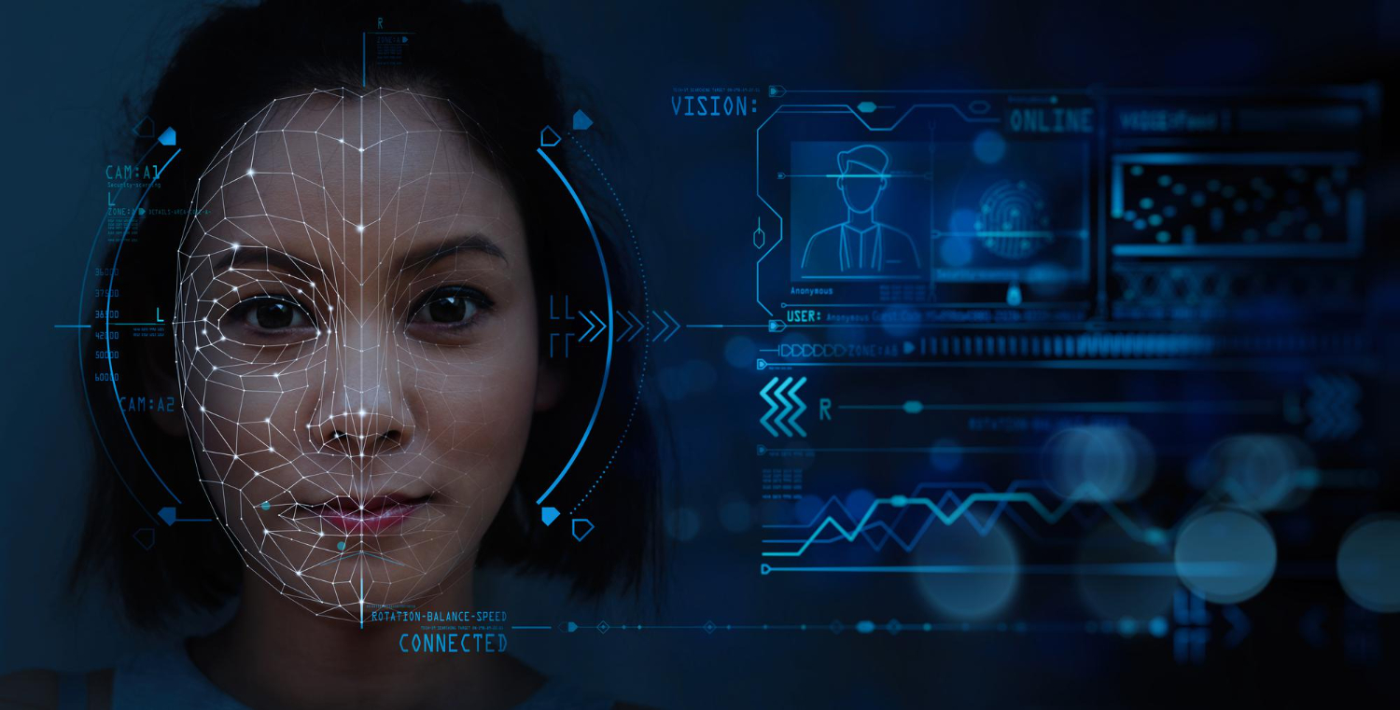
IMPLEMENTATION & TESTING

Slide 11
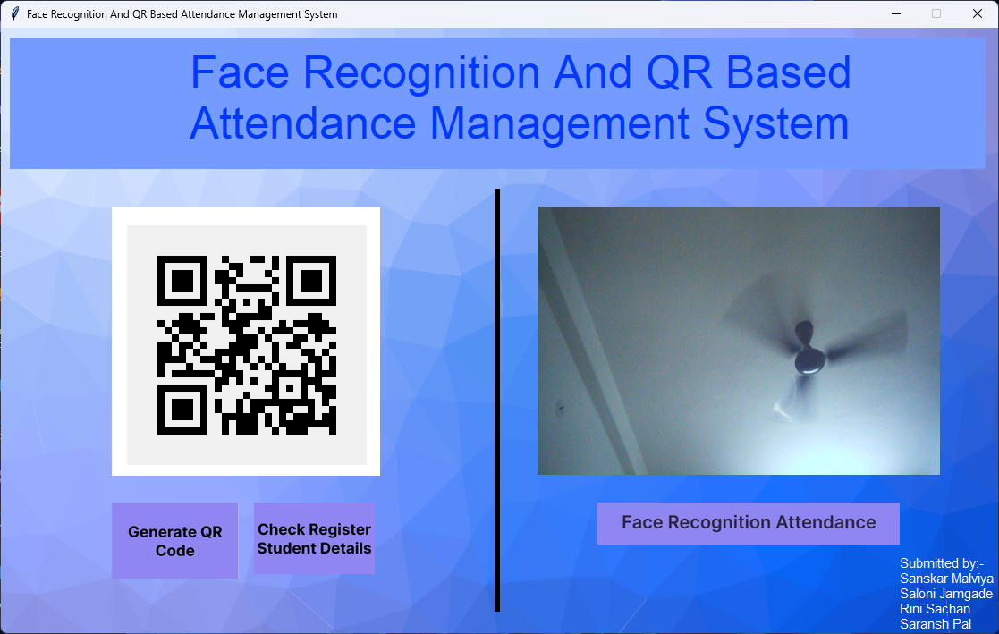
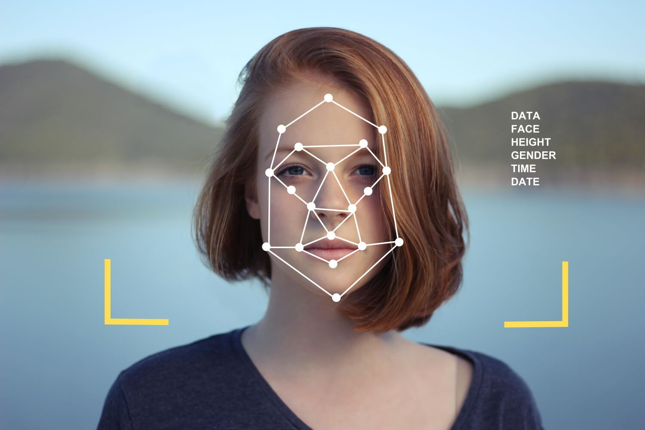

Slide 12
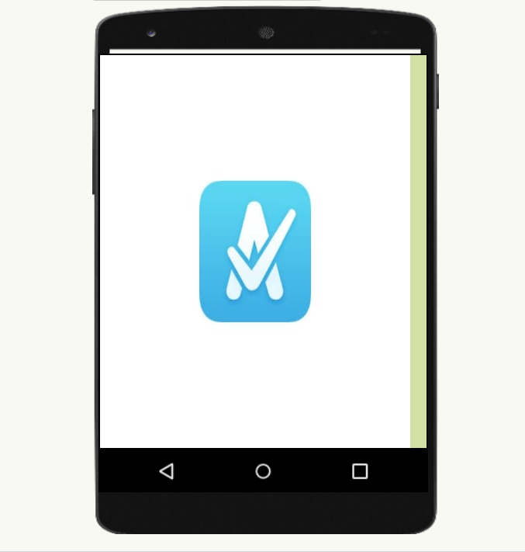
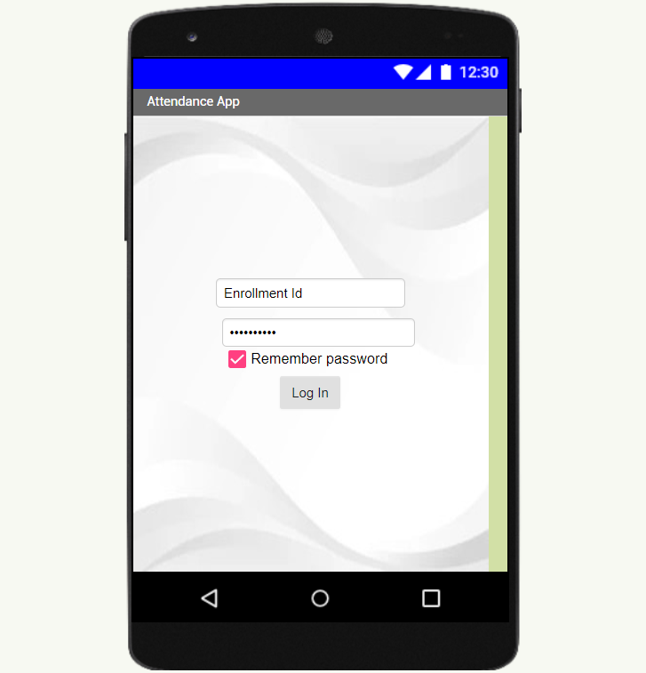
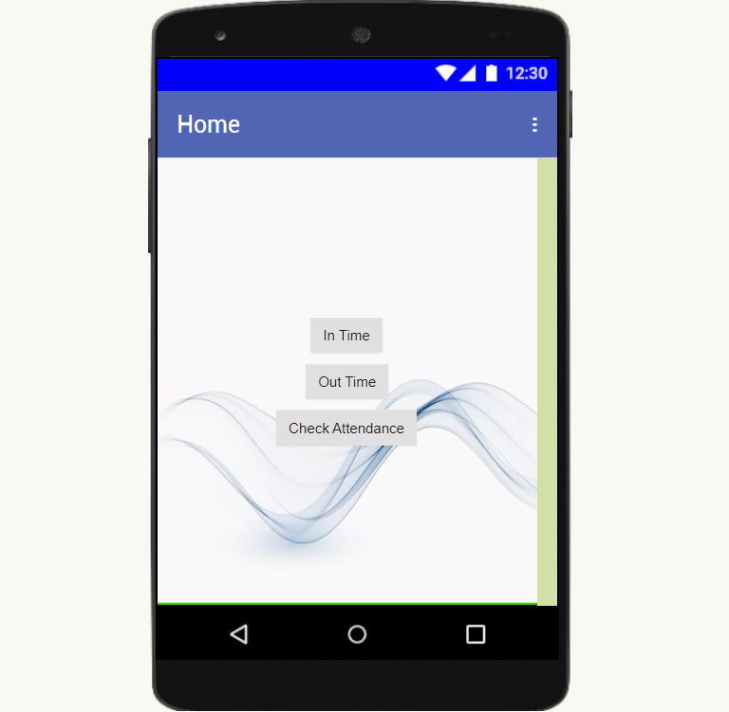
For QR System

Slide 13
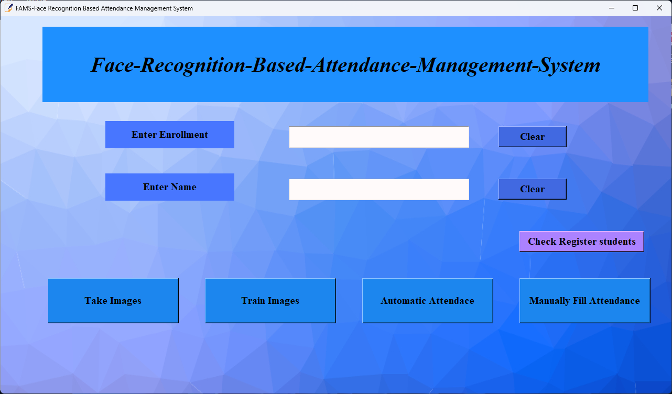

Slide 14

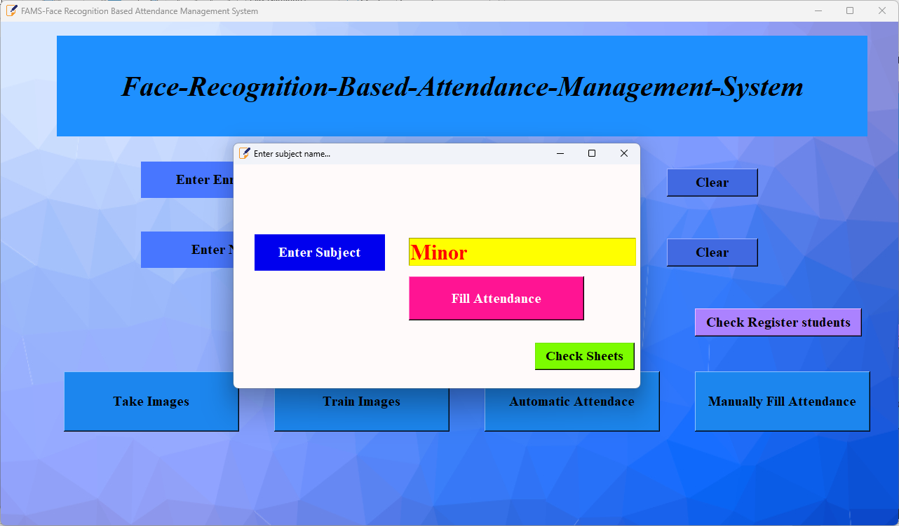

Slide 15
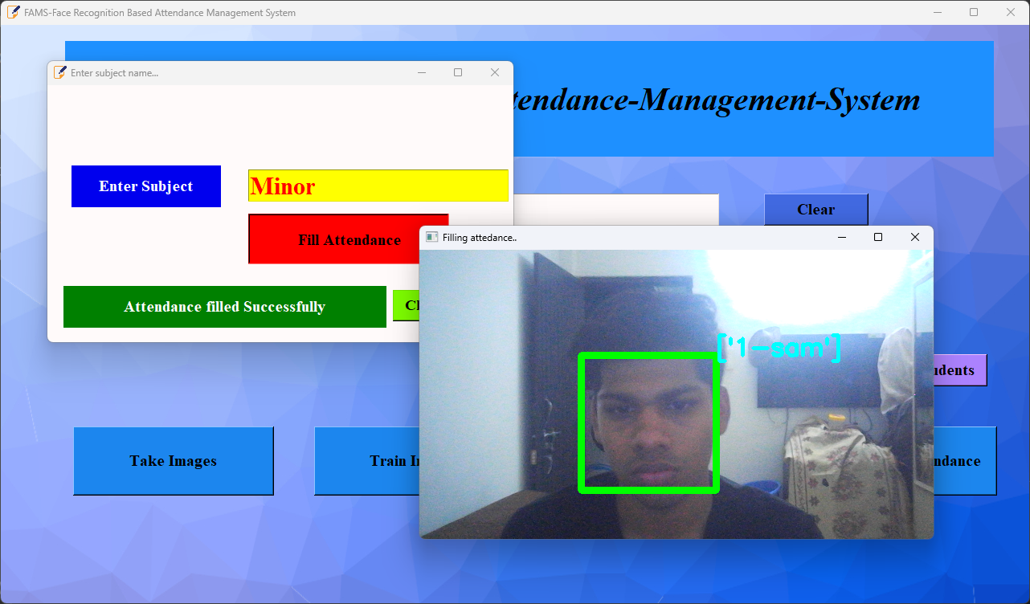
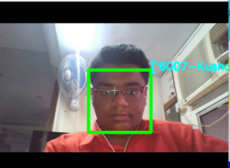

Slide 16
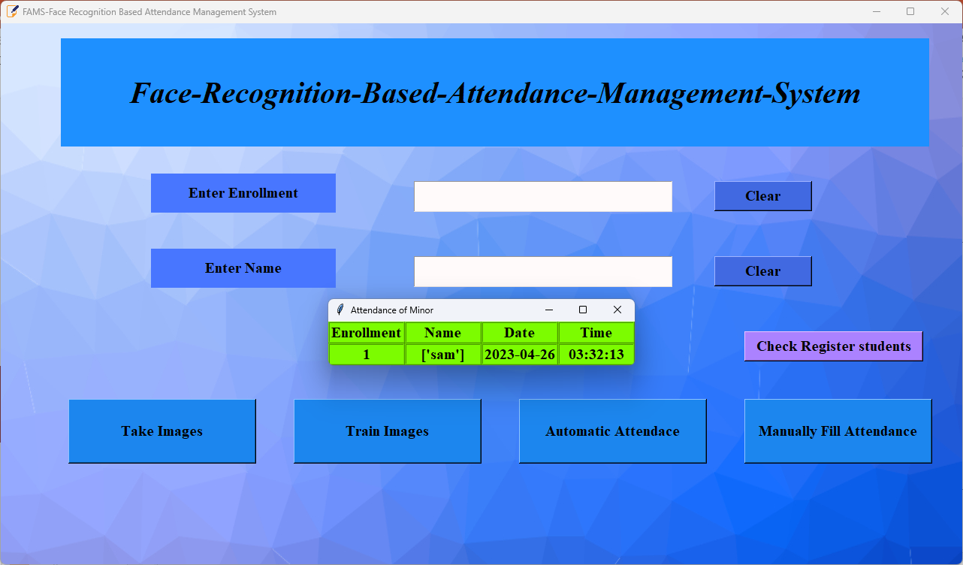

Slide 17
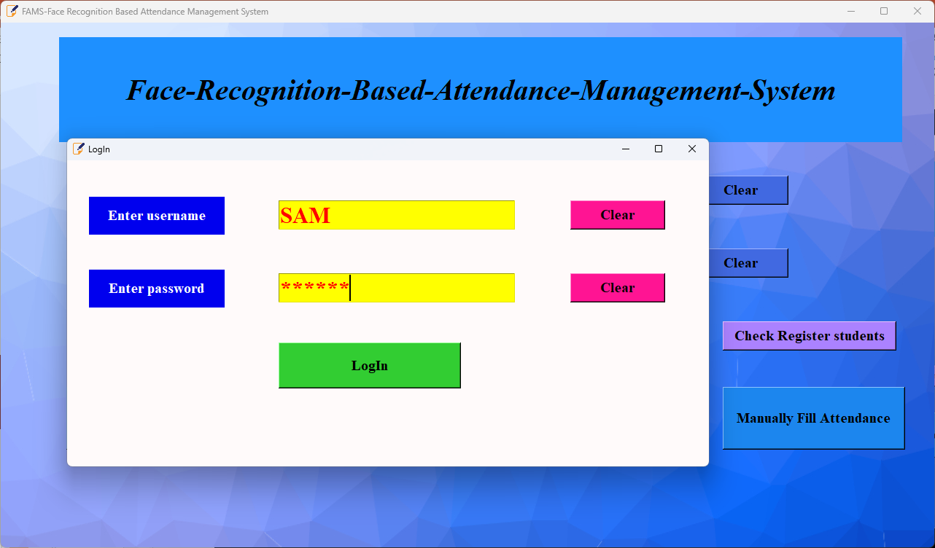

Slide 18
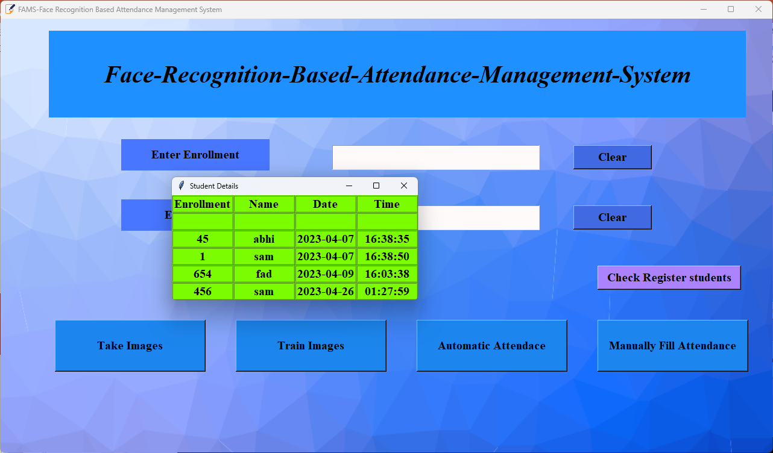

Slide 19

Applications
Schools and universities
Healthcare
Our Attendance management system app can be used to track student attendance, monitor tardiness, and generate reports for teachers, parents, and administrators.
This can help identify patterns of absenteeism or lateness and allow for early intervention.
Attendance management system apps can be used in healthcare settings to track patient appointments, manage patient schedules, and generate reports for healthcare providers.
This can help improve patient outcomes by reducing wait times and improving the efficiency of healthcare delivery.

Slide 20
Applications
Businesses
Our Attendance management system app can be used to track employee attendance, vacation days, and sick leave.
This can help managers ensure that staffing levels are appropriate, and it can also help prevent time theft and other types of fraud.
Events
Our Attendance management system app can be used to track attendance at conferences, seminars, and other events.
This can help organizers plan for future events and improve the attendee experience by identifying areas for improvement.
.
.

Slide 21

Future Scope
Integration with other systems: Our Attendance management system app can be integrated with other systems such as HR management, payroll management, and time tracking. This would allow for more efficient and accurate reporting, reduce manual data entry, and eliminate the need for multiple software solutions.
Mobile access: Attendance management system apps could continue to evolve to offer more mobile-friendly features. This could include push notifications, alerts, and real-time reporting from a mobile device.
Predictive analytics: Attendance management system apps could use predictive analytics to forecast future attendance trends, identify patterns of absenteeism or lateness, and provide insights to improve attendance and productivity.

Slide 22

Conclusion
Finally, in the student attendance management system, the outcome of all the hard work done for the attendance management system is here. It is software that helps the user to work with the attendance. This software reduces the amount of manual data entry and gives greater efficiency.
The User Interface of it is very friendly and can be easily used by anyone. It also decreases the amount of time taken to write details and other modules. This Attendance Management System is a solution to all the problems related to the attendance, message, etc.
In the end, we can say that this software is performing all the tasks accurately and is doing the work for which it is made and this system can be implemented in N number of colleges, schools, healthcare and other places.

Slide 23




Thank you
.

